Slide 1
Fayetteville-Cumberland Parks and Recreation
Basketball Coaches Meeting

Slide 2
Welcome!
Thank you for coaching.
We are all facing new challenges.
This would normally be an in-person meeting.
Have fun this year!
Notes:
We here at Fayetteville-Cumberland Parks and Recreation greatly appreciate you volunteering to coach this winter basketball season! This presentation will go over the most important information that we need you to understand and follow for this upcoming season.

Slide 3
Agenda
Role and Expectation of Coaches
Eligibility
FCPR Code of Conduct
Review of Rules for Youth Basketball

Slide 4
Roles and Expectations of Coaches

Slide 5
Coaching Eligibility
The following are the “disqualification standards” implemented by the Fayetteville-Cumberland Parks and Recreation Department for its Volunteer Background Check. SEX OFFENSE CONVICTIONS A. All Sex Offense Convictions – Regardless of the amount of time since conviction. Examples: Child molestation, rape, sexual assault, sexual battery, sodomy, prostitution, solicitation, indecent exposure, etc. FELONIES A. All Violent Felony Convictions – Regardless of the amount of time since conviction. Examples: Murder, manslaughter, aggravated assault, kidnapping, robbery, aggravated burglary, etc. B. All Felony convictions other than violence or sex within the past 10 years. Examples: Drug offenses, theft, embezzlement, fraud, child endangerment, etc. MISDEMEANORS A. All misdemeanor violence convictions within the past 7 years. Examples: Simple assault, battery, domestic violence, assault on a female, etc. B. Any misdemeanor drug & alcohol convictions within the past 5 years or multiple offenses in the past 10 years. Examples: Driving under the influence, simple drug possession, drunk and disorderly, public intoxication, possession of drug paraphernalia, etc. C. Any other misdemeanor within the past 5 years involving the endangerment of children or is directly related to the functions of that volunteer. Examples: Contributing to the delinquency of a minor, providing alcohol to a minor, theft – if person is handling monies, etc. ANY OTHER CONVICTION WHICH IS DEEMED A POTENTIAL DANGER TO CHILDREN WHICH IS DIRECTLY RELATED TO THE FUNCTIONS OF THAT VOLUNTER
Background Checks are required for all interested candidates. By submitting an application for Background Check, candidates are agreeing to adhere to the Fayetteville-Cumberland Parks & Recreation Code of Conduct.
To begin the application process,visit the Coaches Resources page at www.fcpr.us.You will be directed to an external site to process a secure background check through Southeastern Security Consultants, Inc.
Notes:
Coaches are volunteers for our sport programs. All prospective coaches must complete a background check and it must be approved before practices can begin and before child information is passed out. Once the background check has cleared, the coach will be issued a badge that they are required to wear during all practices and games. A new badge will be printed for each sport that is coached. Coaches are expected to set good examples of sportsmanship and to monitor their teams to ensure players and parents are also displaying good sportsmanship. Please familiarize yourself with the Code of Conduct that was passed out and the rules, regulations, and consequences of not following them. If you have any questions, please feel free to ask a FCPR staff member after the meeting. It is expected that coaches have a team meeting prior to the first practice to discuss team rules and expectations with players and parents. Things to discuss are practice schedule, attendance policy, emergency contacts, disciplinary actions and anything else that is necessary. Each recreation center should have a copy of these rules for each team.

Slide 6
COMMUNICATION
Parent Meeting / Team Meeting
Practice Schedule
Game Schedule
Changes
***Coaches, YOU are the first contact for parents in regards to questions!
Please be sure that parents have a way of contacting you!***
Notes:
Communication is key in helping to run a smooth season. Coaches/coaching staff needs to have good communication with recreation center as well as parents of players. Coaches should host a parent/team meeting. At this meeting they should discuss the expectations and rules that are set in place for their team. IT IS A GOOD IDEA TO SET UP A GROUP TEXT OR USE AN APP LIKE GROUPME TO COMMUNICATE WITH PARENTS. Parents should receive a copy of this and so should the recreation center to be kept on file. These rules will be followed for the season and if at any point in time a parent has a question about the rules, they should be able to speak to their coach. Once practice dates and times have been decided, only those children that have fully gone through the registration process and are not missing any information will receive a phone call from the coach about practice dates and times. If the child is missing any portion of the registration process, they will not be contacted until all requirements are fulfilled. Once the athletic department has issued out game schedules, these will be given to the coach with copies for their team. Game schedules are also posted in the recreation center by the gym.
If there are any changes that are made, coaches need to communicate this with the recreation center immediately. These changes include but are not limited to: not having practice, child not participating in game due to rule violation, child no longer wishing to play. If anything changes on the recreation side that interferes with the schedule (i.e. school events, other rec center programs, maintenance to building), the recreation center staff will communicate this with the coaching staff as soon as possible.

Slide 7
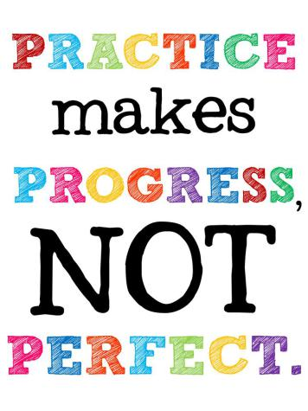
PRACTICES
Dates and Times
Offense and Defense
Scrimmages
Conditioning
Notes:
Rule #1: Only those children that have successfully completed the registration process should be practicing. These should be the only children the coach has contacted in regards to practice. Children that have not successfully completed the registration process are not to be practicing with the team until everything is complete! This rule is to be followed and upheld by recreation center staff and coaching staff.
Rule #2: Coaches, you are responsible for each child that is on your roster during practices and games. When practices and games have concluded, you are to remain on-site until each child’s parent/guardian has come to get their child.
Dates and Times: Practice times are limited to at max 3 hours of practice a week. Please speak with recreation center staff as soon as possible about your availability for practices. We are thankful for you volunteering to take on this responsibility and want to be able to work with you as much as possible in regards to your availability to practice.
Conditioning: Be sure to use basketball related drills to help with getting players in better condition to perform well in practices and games. Keep in mind those that may have medical conditions that may not allow them to perform at a higher level like other participants. Go into practice with a game plan / agenda. The more structured the practices are the more the children can get out of them.
Offense: Please remember that successful offense is about execution, not complexity or trickery. Choose one offensive set-up and one set offensive out of bounds play and run them in practice until it is second nature to the players. Having an extensive playbook in youth basketball is not necessary. If children are having difficulty with running the play correctly, repeat it as necessary, or maybe break it into parts to help perfect. In regards to shooting, for the younger age groups, understand that the correct shooting “form/technique” comes with the strength of the player. Allow them to shoot the ball how they need to. Enforce the tip of “Shooting Up, Not Out.” For the older children, provide shooting drills and tips on better rotation and getting into a solid shooting position.
Defense: Start with proper defensive stance and footwork that leads into shot challenging, rebounding and team defensive concepts. Work on defensive slides or sprinting down court to get in defense position. Focus the mindset early on the importance of defense. Make sure children begin to understand that offense comes as a result of a good defense.
Free Throws: Coaches please practice with your players the proper formation for lining up with free throw shots. This would help to elevate time spent during the games with officials having to line them up.
Practices should be showing children what you expect to happen in the game. Be sure to make eye contact and ask questions to the kids to make sure they are understanding their role in particular plays and reinforce what they should be doing. Focus on getting maximum effort from each player and make sure to give constant feedback on effort. Keep practices simple, focused and fun!

Slide 8
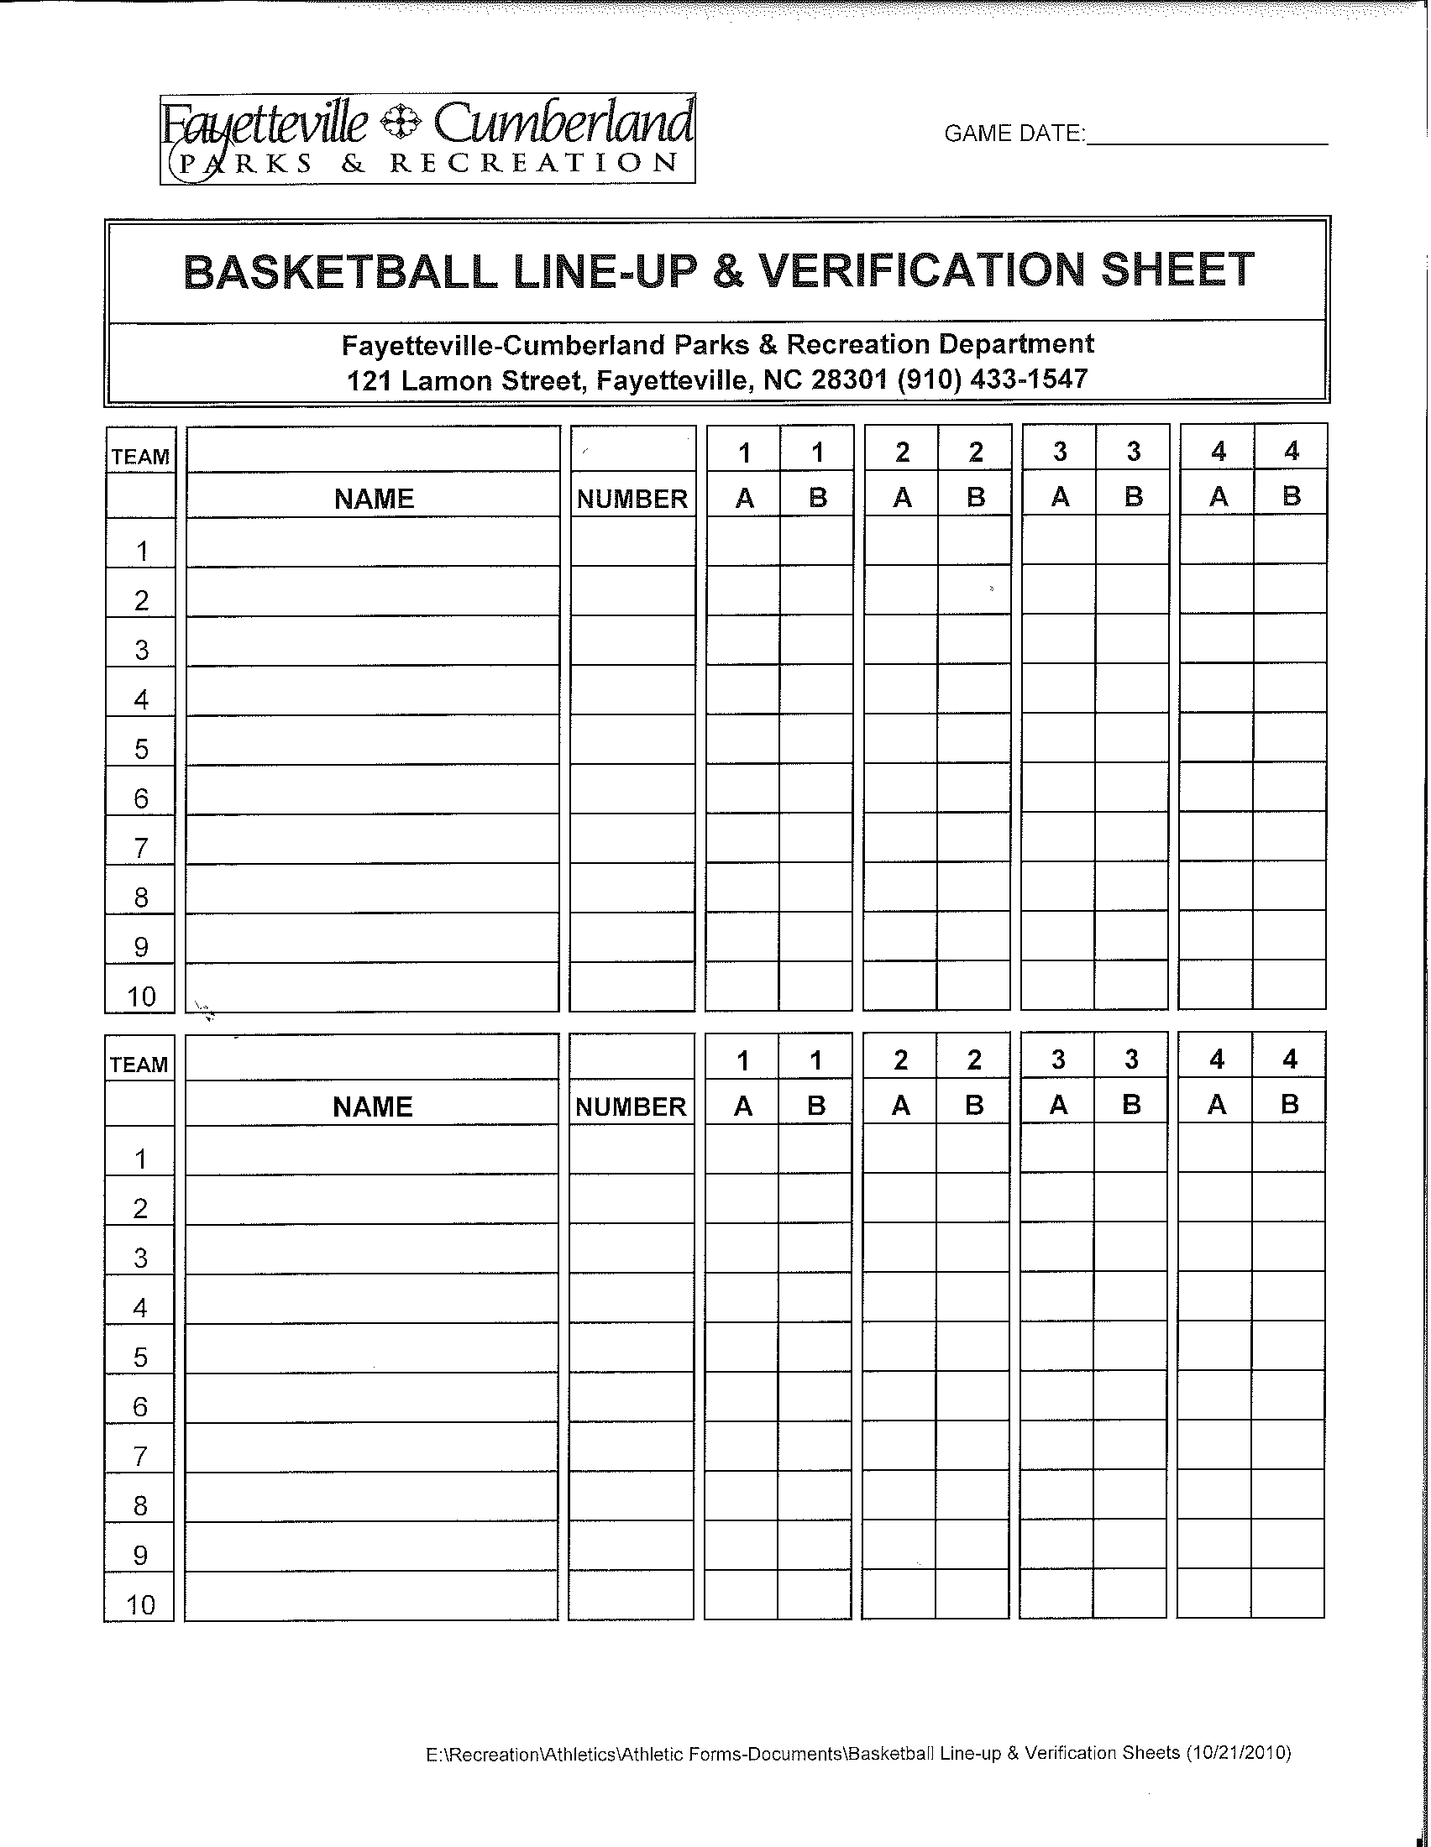
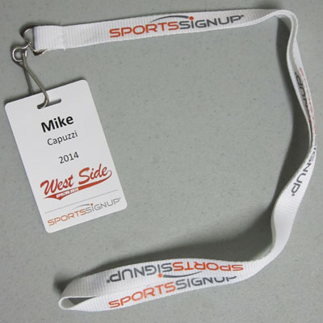
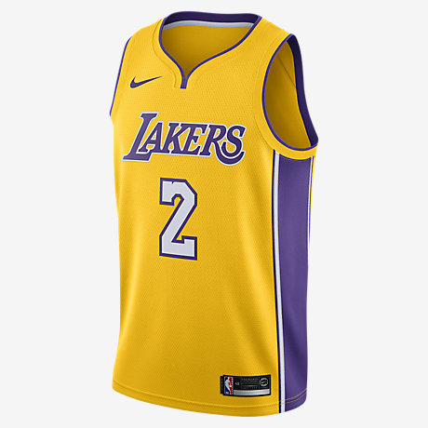
GAMES
Coaches & Badges
Line-Up Sheets
Uniforms
Notes:
Coaches: Only coaches that are on the approved list and have been linked to the team are allowed on the sidelines with the team. Coaches must have their badges for games and practices.
Line-up Sheets: Line up sheets are due to the scorekeepers table 15 minutes prior to game time. Please list on line up sheet: Center Name, Team Name, Game Date, Facility Location, Head Coach First and Last Name and any Assistant Coach First and Last Name, and each player’s First and Last Name with jersey number. DO NOT MARK when you plan on playing each child, children will be checked off by the scorekeeper before each quarter.
Uniforms: FCPR does a mass order of shirts for basketball participants. It is not mandatory for parents to purchase store bought uniforms for their children. Shorts with pockets are not permitted! Coach must cover the opening of the pocket with tape. Players are not allowed to turn shorts inside out in order to play. If a player comes with pockets in their short, they WILL NOT PLAY! NO JEWELRY OR HARD PLASTIC ITEMS (BEADS, ETC) CAN BE IN THE HAIR

Slide 9
OFFICIALS & COMPLAINTS
Expectations
Junior Officials Program
Complaint Process
Notes:
Officials will make mistakes and are not expected to nor can they make every call correctly. Officials are extension of our FCPR staff and are impartial in the game. If you have a concern with an official only the Head Coach is allowed to address them. Applications to become an official are available by contacting Ernie Fisher at erniefisher@nc.rr.com.
The Junior Officials Program allows teens the opportunity to learn how to officiate youth sports. Youth can register for these at any recreation center. The courses include life skills, communication, decision making and conflict resolution. This is free for youth to register for.
If at any time during the game or after you or a parent have a complaint about the game, please see recreation center staff for a complaint form to be filled out and sent in. These forms are used to help us evaluate the program and are passed off to the appropriate supervisory staff member.

Slide 10
FCPR’s
Code of Conduct
Notes:
OFFENSE & PENALTY (to include but not limited to:)
Level 1 - Standard
Offense Failure to follow departmental established guidelines, rules, policies and procedures as applicable to related programming; failure to comply with an FCPR official’s decision; taunting/mocking/harassment of players; disgruntled expressions such as rude gestures or comments, screaming and loudly disagreeing with others or obscene/profane/vulgar language; throwing/kicking/striking of bats, balls and other miscellaneous equipment; unnecessary roughness among participants.
Penalty Not necessarily preceded by a warning…immediate ejection and removal from the premises and a minimum ten (10) day suspension.
Level 2 - Verbal
Offense Malicious obscene/profane/vulgar verbal abuse directed towards another individual; verbal epithets related to race, color, religion, creed, gender or sexual orientation; verbal communication of threats, physical violence or acts of insulting another with intention to offend, defame or embarrass.
Penalty Not necessarily preceded by a warning…immediate ejection and removal from the premises and a minimum thirty (30) day suspension.
Level 3 - Physical
Offense Physical aggression towards another; pushing, shoving, striking or touching another individual with the perceived intent to incite, inflict or cause harm; invading another individual’s personal space during a dispute.
Penalty Not necessarily preceded by a warning…immediate ejection and removal from the premises and a minimum one hundred eighty day (180) day suspension.
Level 4 - Unlawful
Offense Any violation of North Carolina law; possession of firearms, knives, explosive devices weapons or under the influence of alcohol, narcotics, controlled substances, chemical or drug paraphernalia; assault with or without a weapon.
Penalty Not necessarily preceded by a warning…immediate ejection and removal from the premises and a minimum one (1) year suspension.
*** PLEASE NOTE: Suspensions will be tracked and monitored. Individuals who have been
Suspended will be immediately placed on probationary status for a period of one (1) year from the
date of the offense. A second offense by the same individual within one (1) year, regardless of
nature, will result in double the term of the penalty and an extension of probationary period from
the date of the second offense. A third violation by the same individual within one (1) year,
regardless of nature, will void all FCPR privileges indefinitely. Failure to comply with these
guidelines will result in legal action. ***

Slide 11
OFFENSES AND PENALTIES
Please note that no matter the level of the offense, the penalty is:
“Not necessarily preceded by a warning” and will be met with “immediate ejection and removal from premises.”
Suspensions are tracked and monitored and failure to comply with these guidelines will result in legal action.
Notes:
Remember…this is a game. Recreation. Not professional. The players are learning. The referees are learning. The coaches are learning. No scholarships or pro contracts are being awarded here.

Slide 12
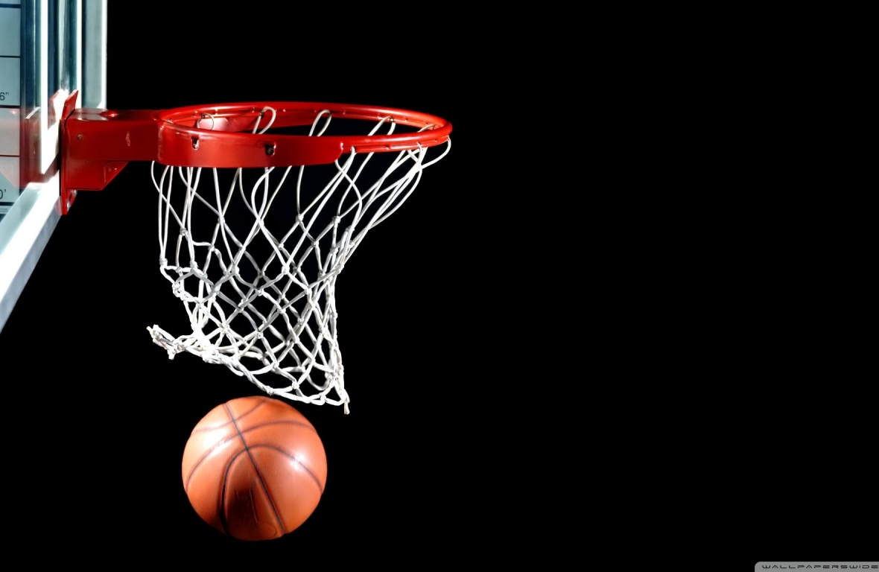
Youth
Basketball
Rules

Slide 13
Rule Comparison Sheet
Please refer to the Basketball Rules Comparison Sheet on the next slide!
Notes:
FCPR staff needs to cover the rule comparison sheet with coaches, placing emphasis on the NO POCKETS, NO JEWELRY, NO PLASTIC ITEMS IN HAIR

Slide 14
 | 8U | 10U | 12U | 14U | 17U | ADULT
Ages | 7,8 | 9,10 | 11,12 | 13,14 | 15,16,17 | 18 up
Time | eight 4-minute sub quarters | eight 4-minute sub quarters | eight 4-minute sub quarters | four 8-minute quarters | four 8-minute quarters | two 20 minute halves
Running Clock | until last 2 minutes of 2nd/4th quarter or 40 point lead | until last 2 minutes of 2nd/4th quarter or 40 point lead | until last 2 minutes of 2nd/4th quarter or 40 point lead | until last 2 minutes of 2nd/4th quarter or 40 point lead | until last 2 minutes of 2nd/4th quarter or 40 point lead | until last 2 minutes of the half or 40 point lead
Overtime | no | 4 minutes, regulation clock | 4 minutes, regulation clock | 4 minutes, regulation clock | 4 minutes, regulation clock | 4 minutes, regulation clock
Ball Size | intermediate (28.5") | intermediate (28.5") | intermediate (28.5") | girls (28.5) boys official (30") | official (30") | official (30")
Goal Height | 8 ft. | 10 ft. | 10 ft. | 10 ft. | 10 ft. | 10 ft.
3 seconds | no | yes | yes | yes | yes | yes
Pressing in backcourt | no | last 2 minutes of 4th unless leading by 15 | entire 2nd half, unless leading by 15 | anytime, except when leading by 15 | anytime, except when leading by 15 | anytime
Minimum Play | 4 minutes each quarter | 4 minutes each quarter | 4 minutes each quarter | in each quarter | in each quarter | n/a
Foul Out | YES (6 fouls) | yes | yes | yes | yes | yes
Foul Line Distances (from the backboard) | 12 feet | 12ft/15ft (optional) | official | official | official | official
Time Outs | 4 per game | 4 per game | 4 per game | 4 per game | 4 per game | 4 per game
Roster Size | 7 minimum, 10 max. | 7 minimum, 10 max. | 7 minimum, 10 max. | 7 minimum, 12 max. | 7 minimum, 12 max. | 12 max
Alternating possession arrow | for each new sub-quarter (held ball stays w'offense) | for each new sub-quarter & tie-ups | for each new sub-quarter & tie-ups | for each new quarter & tie-ups | for each new quarter & tie-ups | for 2nd half & tie-ups
Basketball Shorts | no pockets | no pockets | no pockets | no pockets | no pockets | no pockets
Hair beads | permitted if secured to head | permitted if secured to head | permitted if secured to head | permitted if secured to head | permitted if secured to head | permitted if secured to head
Jewelry | no | no | no | no | no | no
foul shots will be attempted in all programs
on the 7th team foul of the half, shoot 1 & 1 (bonus)
on the 10th team foul of the half, shoot 2 free throws (double bonus)

Slide 15
Youth Basketball Local League Rules and Regulations
Please refer to the Youth Basketball Rules!
Notes:
Staff needs to go over the rules sheet with coaches. Answer questions, place emphasis on rules 2:04, 3:02, 3:05, 3:10, 3:13.

Slide 16
Rule 2:04 - Shorts Shorts with pockets are not permitted!
Notes:
Center and Off-Site Staff will not have tape. Players will not be allowed to play if shorts are worn with pockets attached (you may not flip the shorts inside out). If you order shorts, make sure they don’t have pockets.

Slide 17
Rule 4:06 – Basic Rules For All Sport Jewelry will not be allowed. *Hair adornments (beads) must be fastened securely to prevent injury. Religious and medical-alert medals are not considered jewelry. A religious medal must be taped and worn under the uniform. A medical alert medal must be taped and may be visible.

Slide 18
Rule 3:02 - Running Clock Running clock will occur during free throws except in described situations.
Notes:
1) The free throw is attempted in the last 2 minutes of the second and fourth quarters;
2) The free throw is attempted after a time-out;
NOTE: In the above situations, the clock will not start until the ball is put back into play after the conclusion of the free throw attempts.

Slide 19
Rule 3:05 - Player Participation Failure to follow minimum requirement is grounds for suspension!
Notes:
Explain minimum play requirement and emphasize the importance of communication between teams, coaches and recreation center staff members.
3:05 PLAYER PARTICIPATION REQUIREMENT (8U, 10U, and 12U)
Each player must play at least 4 minutes each quarter.
There will be an official time-out at the 4-minute mark of each quarter so that coaches can make substitutions.
Coaches will have 1 minute during the time-out to go on the court and make the necessary changes.
NO SUBSTITUTIONS WILL BE MADE PRIOR TO OR AFTER THE 4-MINUTE MARK UNLESS THERE IS AN INJURY OR EJECTION.
PLAYERS MUST LINE UP IN FRONT OF THE SCOREKEEPER TO CHECK IN TO THE GAME.
ALL PLAY RULE DOES NOT APPLY IN OVERTIME.
NOTE: If a team has less than 10 players present, some players will be allowed to play more than the minimum amount of minutes required. Example: Team A has only 9 players at the game; Ruling: Team A would be allowed to play 1 player more than the minimum amount.
3:07 PLAYER PARTICIPATION REQUIREMENT (14U and 17U)
Each player must play in each quarter.
3:08 If a team violates the minimum play requirement, the head coach shall be suspended in accordance with the Code of Conduct.

Slide 20
Rule 3:10 - Substitutions Injured player substitution rule.
Notes:
Explain the different between this rule and the rule if a player is ejected or fouled out.
8U, 10U, 12U leagues: if a player is injured and cannot continue to play within a reasonable time, the official will allow a substitution to be made for the injured player. The opposing coach shall select the substitute. The injured player must return at the next dead ball, if physically able to play. If a player fouls out of the game, the coach will select a player from his or her bench (not the opposing coach).

Slide 21
Rule 3:13 – Backcourt Pressing Backcourt pressing and violations for penalty.
Notes:
3:13 BACKCOURT PRESSING:
8U league - No player on the defensive team may check or press in the backcourt at anytime during the game. The defense must retreat to inside the 3 point line until the ball crosses the mid-court line.
10U league - No player on the defensive team may check or press in the backcourt until the last 2 minutes of the 4th quarter; teams can press the entire overtime period; cannot press when leading by 15 points or more.
12U league - No player on the defensive team may check or press in the backcourt until the 2nd half; teams can press the entire overtime period; cannot press when leading by 15 points or more.
14U and 17U leagues – Anytime except when leading by 15 points or more.
ALL LEAGUES: When pressing is not allowed, the defense must allow the ball to cross the half court line into the frontcourt.
PENALTY FOR VIOLATION:
1st offense – warning to the offending team.
Starting with the 2nd offense a technical foul will be assessed to the offending team and the offended team will be awarded 2 free throws and the ball.
The coach is not ejected.

Slide 22
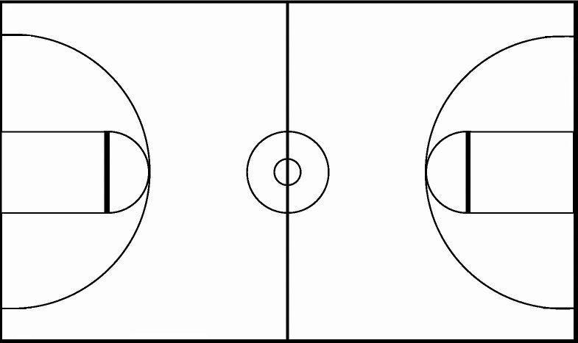
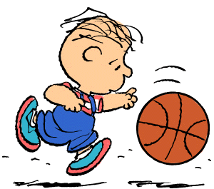
8U DEFENSE must stay behind this line until ball comes across the half-court line.
Offense moving down court
Offense moving down court
8U DEFENSE must stay behind this line until ball comes across the half-court line.

Slide 24
Text Alerts
Text FCPRD to 84483 to sign up for text alerts
Notes:
In an effort to reduce needless texts, at the end of each season staff will clear out all phone numbers. Coaches will need to sign up at the beginning of each season if they want to received rainout/cancellation texts.

Slide 25
25 Misunderstood Rules in High School Basketball
1. There is no 3-second count between the release of a shot and the control of a rebound, at which time a new count starts. It does no good to continuously yell “3 SECONDS”
2. A player can go out of bounds, and return inbounds and be the first to touch the ball ! Comment: This is not the NFL. You can be the first to touch a ball if you were out of bounds. However, you must establish yourself as inbounds. “Something in, nothing out”.
3. There is no such thing as “over the back”. There must be contact resulting in advantage/disadvantage. Do not put a tall player at a disadvantage merely for being tall!
4. “Reaching” is not a foul. There must be contact and the player with the ball must have been placed at a disadvantage.
5. A player can always recover his/her fumbled ball; a fumble is not a dribble, and any steps taken during recovery are not traveling, regardless of progress made and/or advantage gained! (Running while fumbling is not traveling!) Comment: You can fumble a pass, recover it and legally begin a dribble. This is not a double dribble. If the player bats the ball to the floor in a controlling fashion, picks the ball up, then begins to dribble, you now have a violation.
6. It is not possible for a player to travel while dribbling. Comment: Basketball Fundamental #6. Page 73 of the Rule Book.
7. A high dribble is always legal provided the dribbler’s hand stays on top of the ball, and the ball does not come to rest in the dribblers’ hand. Comment: The key is whether or not the ball is at rest in the hand.

Slide 26
25 Misunderstood Rules in High School Basketball
8. A “kicked” ball must be intentional, and contact must be any part of the leg. Comment: MUST be intentional. We miss this too many times at the lower levels.
9. It is perfectly legal for a player to rebound his/her own air ball, provided the official deemed the shot a legitimate shot. Comment: Case Book 4.44-B describes this play exactly.
10. It is impossible to travel, double dribble or carry while taking the ball out for a throw in. I have seen officials tell athletes they can't move on a throw-in. Why? This is not a rule. You have limitations but you can move. Comment: They must stay over the spot in a lateral manner. Rule 4-42-6 ---- The spot is 3 feet wide and has no restrictions on depth.
11. A ball cannot travel over the top of the back board, however, it can travel behind the backboard. Comment: The ball can pass through the poles, wires, standards, etc, provided that it does not touch anything.
12. A defender does not have to “give the dribbler a step”. As long as legal guarding position has been established, it is up to the dribbler to avoid contact. The person with the ball should expect to be guarded. Comment: Legal guarding position is the key. Time and distance are not an issue when guarding someone with the ball. Rule 4-23-4.
13. The sides, top, and bottom of a rectangular backboard are IN BOUNDS.

Slide 27
25 Misunderstood Rules in High School Basketball
14. Jumpers may tap the ball simultaneously; may tap the ball twice; and when a legally tapped ball touches the floor, a player other than a non-jumper, or a backboard, then the jump ball has ended, and either jumper may recover it! Comment: Rule 4-28-3
15. A 10 second count continues when the defense deflects or bats the ball. Comment: The count ceases only when possession changes.
16. A "moving screen" isn't a violation unless there is contact. (If contact occurs, it’s a “BLOCK”, which is a foul.) Comment Rule 4-40
17. Any contact foul during a live ball is personal, not technical! Comment: The contact can be flagrant, but never technical.
18. Basketball is NOT a non-contact sport. Incidental contact does occur, and contact which does not create an advantage/disadvantage may be ignored. Contact on the shooter should be called.
19. Any unsportsmanlike contact during a dead ball is a technical foul!
20. A defensive player does not have to be stationary to take a charge…. he or she simply must have established a legal guarding position. The defense can move backward and sideways. Legal guarding position must be established.
21. An intentional foul is always penalized with 2 free throws, except on a missed 3-point shot, which is awarded 3 free throws.

Slide 28
25 Misunderstood Rules in High School Basketball
22. When an airborne shooter commits a player control foul, his/her successful try for goal cannot be allowed, regardless of whether the try was released before or after the foul! Comment: Rule 4-1
23. Lifting the pivot foot does not constitute a travel unless the ball handler puts the pivot foot back on the floor prior to beginning a passing, or shooting the ball! The pivot foot cannot be lifted before the dribble is started. Comment: We miss this too many times! Hold your whistle until you see what transpires.
24. It is not goaltending if, after contacting the backboard, the ball is touched by a defensive player, provided the ball has not reached it’s apex and it is not inside the cylinder. Comment: It is legal for a defender in the normal course of trying to block a shot, to contact the backboard with his hand. This is not basket interference. It is a technical foul only if, in your judgment, the contact with the backboard was intentional in nature with no real attempt to block the shot.
25. Basket Interference occurs when: a player touches the ball or basket (net included) when the ball is ON or within the basket; touches the ball when it is touching the cylinder having the ring as its lower base; touches the ball outside the cylinder while reaching through the basket from below. Goal Tending occurs when: a player touches the ball during a try or tap while it is in its downward flight entirely above the basket ring level and has the possibility of entering the basket in flight; or an opponent of the free thrower touches the ball outside the cylinder during a free throw attempt. Comment: Touching the net is only a violation if the ball is in contact with the rim, or is within the basket. It is not a violation if the net is touch while the ball is in the cylinder.

Slide 29
Thank You!
Stay connected with us:
www.fcpr.us
Facebook
Twitter: @parksrecreation
Instagram: fcpr910

Slide 30
BASKETBALL REFERENCE VIDEOS & CLIPS
BASKETBALL FUNDAMENTALS
https://www.youtube.com/watch?v=T9uJp2s0XvU
STANCE
3 Threat https://www.youtube.com/watch?v=nngpVHqzJLw
Box Out https://www.youtube.com/watch?v=ctWYMtXyhDk
Pivoting https://www.youtube.com/watch?v=ctWYMtXyhDk
Ripping https://www.youtube.com/watch?v=CUIUWX2HeHs
PASSING
Passing https://www.youtube.com/watch?v=y9UtZEY6maE
SHOOTING
Shooting https://www.youtube.com/watch?v=dxRBtmCsfBc)
Notes:
Reference videos courtesy of Youtube; obtained through Nelson Soriano, Center Supervisor Smith Recreation Center.

